Slide 1

Open Shortest Path First (Basic)
Safwan Muntasir (Sufi) Networking Enthusiast

Slide 2
Introduction
The history of OSPF can be traced back to the early 1980s, when the internet was still in its early stages of development. At the time, the most common routing protocol was RIP (Routing Information Protocol), but RIP had a number of limitations, such as its inability to support large networks or to distribute external routes.
In response to the limitations of RIP and to develop a new routing protocol, the IETF (Internet Engineering Task Force) -
Formed a working group in 1998.
In 1991, published RFC 1247, which defined the first version of OSPF.
In 1998, published RFC 2328, which defines the current version of OSPF (OSPFv2).
In 1999, published RFC 2740, which defines OSPFv3 for IPv6 networks.
OSPF is now one of the most widely used routing protocols worldwide. In fact, it the most used IGP (Interior Gateway Protocol). OSPF has continued to evolve over the years, and the IETF continues to publish new RFCs that define new features and enhancements for OSPF. OSPF is an IGP (Interior Gateway Protocol) but it can also Redistribute External Routes from different Autonomous System into its routing table. This routing protocol is known for its scalability, reliability and support for advanced features such as authentication and traffic engineering.
Notes:
Dijkstra’s Algorithm: Dijkstra's algorithm, named after Dutch computer scientist Edsger W. Dijkstra, is a widely used algorithm in computer science and mathematics for finding the shortest path between nodes in a weighted graph. It is particularly useful in various applications, such as network routing, GPS navigation, and optimizing transportation or communication networks.
AS: An AS is typically operated by a single organization, such as an Internet Service Provider (ISP), a large corporation, a data center, or a university. This entity has control over the routing policies and decisions within its AS.
Link-State: In a Link-State Routing Protocol, each router in the network maintains a database that contains information about the state of its directly connected links. This information includes the status (up or down) and the cost (typically a metric reflecting the link's quality or capacity) of each link. This data is referred to as the router's link-state information. Routers running a Link-State Routing Protocol periodically exchange their link-state information with neighboring routers. This exchange ensures that all routers within the network have consistent and up-to-date information about the state of all links in the network. With complete and synchronized link-state information, each router independently calculates the shortest path to all destinations within the network. Common algorithms like Dijkstra's algorithm are used for this purpose. The result is a routing table that contains the best path (shortest path) to reach each destination.
Protocol 89: In networking, the protocol number 89 is associated with OSPF (Open Shortest Path First) when referring to the Internet Protocol (IP) protocol version 4 (IPv4). This number is used to identify the OSPF protocol at the transport layer of the OSI model. Specifically, it's used in the IP header's "Protocol" field to indicate that the packet is carrying OSPF information.
AD: Administrative Distance is a metric used to assign a preference or trustworthiness value to different routing protocols or information sources in order to help a router determine which route to choose when it receives routing updates for the same destination from multiple sources. The route with the lowest Administrative Distance is considered the most preferred and will be chosen for routing.
DR: Rather than having all routers form adjacencies and exchange OSPF routing information with every other router in the segment, which can be inefficient and lead to unnecessary traffic, OSPF elects a single router as the Designated Router (DR) for that segment. The DR is responsible for representing the entire segment to the rest of the OSPF domain. The DR also sends and receives LSAs (Link-State Advertisements) on behalf of the routers in the segment.
BDR: The BDR is the router with the second-highest priority (after the DR) in a multi-access network segment. The BDR is in a standby or backup role, ready to take over as the DR if the current DR fails or becomes unreachable. Having a BDR ensures network continuity and rapid failover in case the DR goes down.

Slide 3
Key Features
OSPF stands for Open Shortest Path First. It uses Dijkstra’s Algorithm (SPF).
IGP (Interior Gateway Protocol) - route traffic within a single AS (Autonomous System).
Standard Protocol – Cisco/Non-Cisco devices.
Link-State Protocol – sent LSAs (Link-State Advertisement) periodically.
Thus, convergence is Fast (40 seconds).
Protocol number 89.
AD (Administrative Distance) value 110.
Multicast address 224.0.0.5 for normal communication and 224.0.0.6 for update to DR/BDR (Designated Router/Backup Designated Router).
Supports equal Load balancing.
No automatic summarization.
Multiple Areas.
Different OSPF Processes in a single autonomous system.
Supports CIDR (Classless Inter-Domain Routing).
No limit for number of Hops (routers) connected.
Notes:
Dijkstra’s Algorithm: Dijkstra's algorithm, named after Dutch computer scientist Edsger W. Dijkstra, is a widely used algorithm in computer science and mathematics for finding the shortest path between nodes in a weighted graph. It is particularly useful in various applications, such as network routing, GPS navigation, and optimizing transportation or communication networks.
AS: An AS is typically operated by a single organization, such as an Internet Service Provider (ISP), a large corporation, a data center, or a university. This entity has control over the routing policies and decisions within its AS.
Link-State: In a Link-State Routing Protocol, each router in the network maintains a database that contains information about the state of its directly connected links. This information includes the status (up or down) and the cost (typically a metric reflecting the link's quality or capacity) of each link. This data is referred to as the router's link-state information. Routers running a Link-State Routing Protocol periodically exchange their link-state information with neighboring routers. This exchange ensures that all routers within the network have consistent and up-to-date information about the state of all links in the network. With complete and synchronized link-state information, each router independently calculates the shortest path to all destinations within the network. Common algorithms like Dijkstra's algorithm are used for this purpose. The result is a routing table that contains the best path (shortest path) to reach each destination.
Protocol 89: In networking, the protocol number 89 is associated with OSPF (Open Shortest Path First) when referring to the Internet Protocol (IP) protocol version 4 (IPv4). This number is used to identify the OSPF protocol at the transport layer of the OSI model. Specifically, it's used in the IP header's "Protocol" field to indicate that the packet is carrying OSPF information.
AD: Administrative Distance is a metric used to assign a preference or trustworthiness value to different routing protocols or information sources in order to help a router determine which route to choose when it receives routing updates for the same destination from multiple sources. The route with the lowest Administrative Distance is considered the most preferred and will be chosen for routing.
DR: Rather than having all routers form adjacencies and exchange OSPF routing information with every other router in the segment, which can be inefficient and lead to unnecessary traffic, OSPF elects a single router as the Designated Router (DR) for that segment. The DR is responsible for representing the entire segment to the rest of the OSPF domain. The DR also sends and receives LSAs (Link-State Advertisements) on behalf of the routers in the segment.
BDR: The BDR is the router with the second-highest priority (after the DR) in a multi-access network segment. The BDR is in a standby or backup role, ready to take over as the DR if the current DR fails or becomes unreachable. Having a BDR ensures network continuity and rapid failover in case the DR goes down.

Slide 4
Packet Header Format
Version: OSPFv2 for IPv4.
Type: OSPF packet type from 1 to 5. Such as: Hello, DD, LSR, LSU, LSAck.
Packet Length: Total length of the packet in bytes including header.
Router ID: Advertising router ID.
Area ID: To which the OSPF enabled interface belongs.
Checksum: To perform error checking.
Authentication Type: Authentication type ranging from 0 to 2 respectively non-authentication, simple (plaintext) authentication, and MD5 authentication.
Authentication: Data used for authentication.
IP Header OSPF Packet Header OSPF Data
0 7 15 31
Version Type Packet Length
Router ID
Area ID
24 bytes
Checksum Authentication Type
Authentication
Authentication

Slide 5
How it works!
OSPF works in three steps mainly:
Becoming Neighbors: OSPF routers discover and establish neighbor relationships with other OSPF routers on the same network segment by sending Hello packets. To see the neighbor table, type this command in privileged EXEC mode: ‘show ip ospf neighbor’
Exchanging Database: OSPF routers exchange Link-State Advertisements (LSAs) to create and maintain a synchronized link-state database. LSAs contain information about the routers, links, and subnets within the OSPF area. To see the database table, type this command in privileged EXEC mode: ‘show ip ospf database’
Calculating Best Route: OSPF use Dijkstra's algorithm to calculate the shortest path tree (SPF tree). The SPF tree represents the best paths to reach all destinations within the OSPF area. To see the routing table, type this command in privileged EXEC mode: ‘show ip route’

Slide 6
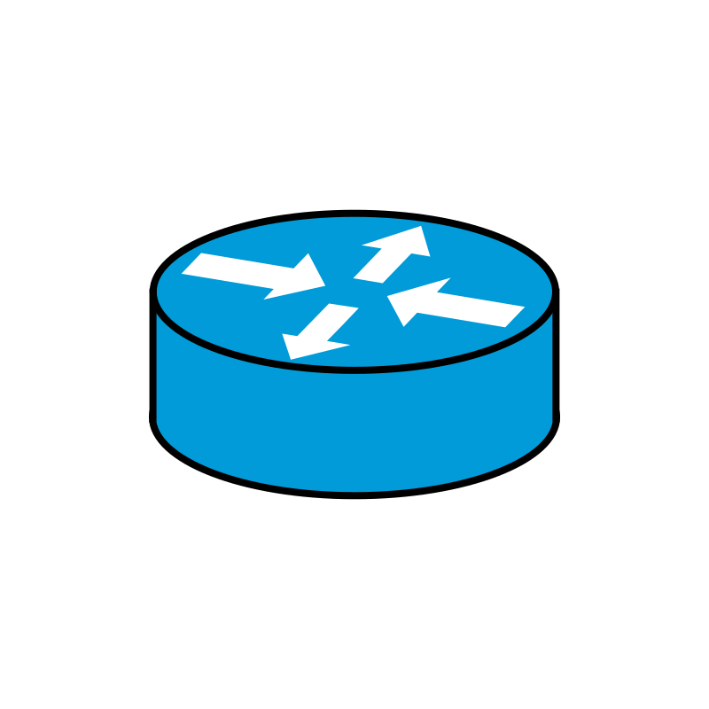
Becoming Neighbors
OSPF process stars with a Hello message. There are 3 states in becoming neighbors:
Hello! My RID: 1.1.1.1
Neighbors: 224.0.0.5 Multicast
Down
Down
Router ID: 1.1.1.1
Router ID: 2.2.2.2
Hello! My RID: 2.2.2.2
Neighbors: 1.1.1.1 Unicast
Down
Init
Router ID: 1.1.1.1
Router ID: 2.2.2.2
Hello! My RID: 1.1.1.1
Neighbors: 2.2.2.2 Unicast
2-Way
Init
Router ID: 1.1.1.1
Router ID: 2.2.2.2
2-Way
2-Way
Router ID: 1.1.1.1
Router ID: 2.2.2.2
Notes:
Down: Routers have not yet established any OSPF neighbor relationship. In this state, routers are unaware of each other's presence on the network. Routers send multicast hello message in this state.
Init: This state indicates that hello packet have been received from another router, but bidirectional communication has not been established.
2-Way: Bidirectional communication has been established and the routers are neighbors. If DR and BDR is needed, this election occurs in this state.

Slide 7
Becoming Neighbors
Router ID: A 32 bit unique number. OSPF router is identified using same ID in all directions. It is selected in following cascading selection:
Manually assigned. ‘Router(config)# router ospf 1’ ‘Router(config-router)# router-id 1.1.1.1’
Highest ‘up’ status loopback interface IP address.
Highest ‘up’ status physical interface IP address.
Conditions: There are some requirements to match to become neighbors:
1. Hello interval 5. Subnet mask
2. Dead interval 6. Authentication
3. OSPF area ID 7. Stub area flag
4. Subnet number 8. Unique router ID
To reset the Router ID, use following command in privileged EXEC mode:
‘Router# clear ip ospf process’
Notes:
Loopback: A loopback interface, often referred to simply as "loopback," is a virtual network interface on a computer or networking device. It is a special-purpose interface used primarily for internal communication within the device itself.

Slide 8
Packet Type 1 (Hello)
Network Mask: The netmask of the interface.
Hello Interval: The default is 10 seconds for broadcast and point-to point networks and 30 seconds for NBMA (Non-broadcast Multi-access).
Options: Indicating the various OSPF router capability, such as whether stub areas are supported in the Options field.
Router Priority: This is a number from 0 to 255, which defaults to 1. The router with the highest value will become the designated router. If the Priority is set to 0, the router does not participate in the DR/BDR selection.
Dead Interval: Time before declaring a silent router down. It is four times hello interval.
DR: IP address of the Designated Router.
BDR: IP address of the Backup Designated Router.
Neighbors: Router ID of the neighbor routers.
IP Header OSPF Header OSPF Hello Packet
0 7 15 31
Network Mask
Hello Interval Options Router Priority
Dead Interval
Designated Router (DR)
Backup Designated Router
Neighbor
…
***Initial DR, BDR & Neighbors are “0.0.0.0”
Notes:
NBMA: It refers to a type of network topology or technology commonly found in computer networking. In an NBMA network, multiple devices or nodes are connected to a common network segment or medium, but unlike a broadcast network (such as Ethernet), NBMA networks do not support the automatic broadcasting of data to all nodes on the network. Instead, communication in an NBMA network typically requires explicit addressing.

Slide 9
Exchanging Database
After becoming neighbors, routers starts to flood the summary information of LSAs. There are some states to become adjacent router:
I will start exchange! My RID: 1.1.1.1
Unicast
Exstart
Exstart
Router ID: 1.1.1.1
Router ID: 2.2.2.2
No, I will start exchange!
My RID: 2.2.2.2 Unicast
Exstart
Exstart
Router ID: 1.1.1.1
Router ID: 2.2.2.2
Here is the summary of my DB!
My RID: 1.1.1.1
DD Packets
Exchange
Exchange
Router ID: 1.1.1.1
Router ID: 2.2.2.2
DD Packets
Here is the summary of my DB!
My RID: 2.2.2.2
Exchange
Exchange
Router ID: 1.1.1.1
Router ID: 2.2.2.2
Notes:
Exstart: This is the first step in forming the adjacencies. Routers identify which router will be the master and slave for the LSDB synchronization.
Exchange: After two routers decides to exchange databases, the do not simply send the content of the full database, just the summary information. During this state, routers are exchanging link states by using Database Description (DD) packets.

Slide 10
Packet Type 2 (DD-Database Descriptor)
Interface MTU: largest IP datagram in bytes that the interface can send without fragmentation. If the MTU sizes do not match, the neighbor will get stuck in the Exstart state.
Options: Indicate the various capabilities of the OSPF router.
5 bits following options are fixed to “00000”.
I (Initial): The Initial bit is set to 1 if the packet is the first DD packet. It is set to 0 if not.
M (More): The More bit is set to 0 if the packet is the last DD packet. It is set to 1 if more DD packets are to follow.
M/S (Master/Slave): The master/Slave bit. M/S-bit=1 indicates that the router is the Master router, otherwise the router is the Slave router.
DD Sequence Number: Ensures that DD packets are received; the router that serves as the Master determines a unique initial value and increments the sequence number in subsequent DD packet exchanges.
LSA Header: A list of LSA headers for all LSAs in the LSDB of the router generating the DD packet.
IP Header OSPF Header OSPF DD Packet
0 7 15 31
M
S
Interface MTU Options 0 0 0 0 0 I M
DD Sequence Number
LSA Header
…
…
LSA Header

Slide 11
Calculating Best Route
Each router can check which LSAs it already has and then ask the router for only remaining LSAs. After the link-state databases of the neighbors are fully synchronized, they become full adjacent and apply algorithm analyzing the LSDB.
I need complete entry for network ‘this’ My RID: 1.1.1.1
LSR Packets
Loading
Loading
Router ID: 1.1.1.1
Router ID: 2.2.2.2
LSU Packets
Here is complete entry for network ‘this’
My RID: 2.2.2.2
Loading
Loading
Router ID: 1.1.1.1
Router ID: 2.2.2.2
LSAck Packets
Thanks for the information!
LSAck Packets
Full
Full
Router ID: 1.1.1.1
Router ID: 2.2.2.2
There is another state named “Attempt” state. It is only seen in NBMA (Non-Broadcast Multi Access) links. In NMBA, we have to manually configure the neighbor’s IP because it doesn’t support multicast. Then, hello packets are sent unicast to manually configured neighbor IP.

Slide 12
Packet Type 3 (LSR-Link State Request)
Link-State Type: It is a number (1-7) that indicates the type of LSA.
LSA type code 1 - Router LSA
LSA type code 2 - Network LSA
LSA type code 3 - Network Summary LSA
LSA type code 4 - ASBR Summary LSA
LSA type code 5 - AS External LSA
LSA type code 7 - NSSA External LSA
Link-State ID: The Link State ID is contained in the LSA header, and what the Link State ID contains depends on the type of LSA. For,
LSA type 1 - the router ID that generated the LSA.
LSA type 2 - the IP address of the DR.
LSA type 3 - the network address of another area generated by ABRs (inter-area routes).
LSA type 4 – the network address of another area (routes to ASBRs).
LSA type 5 - the router ID of the ASBR advertising the external routes.
LSA type 7 - the ABR in the NSSA (Not So Stubby Area) translates type 7 LSAs into Type 5 LSAs before sending them to other OSPF areas..
IP Header OSPF Header OSPF LSR Packet
0 7 15 31
Link-State Type
Link-State ID
Advertising Router
…
Link-State Type
Link-State ID
Advertising Router
Advertising Router: The router ID of the router that generated the LSA.

Slide 13
Packet Type 4 (LSU-Link State Update) & Type 5 (LSAck)
IP Header OSPF Header OSPF LSU Packet
IP Header OSPF Header OSPF LSAck Packet
0 7 15 31
0 7 15 31
Number of LSAs
LSA Header
LSAs
…
…
LSA Header
Number of LSAs: the number of LSAs contained in the LSU packet.
LSAs: LSAs to be advertised in LSU packets; multiple LSAs can be included and advertised in a single LSU packet. The LSA consists of LSA header and LSA data.
LSA Header: A list of received LSA headers; a single LSAck packet can contain multiple LSA headers.

Slide 14
LSA Flooding
R5 LSA
R3
R5 LSA
R5 LSA
R5 LSA
R1
R2
R5
R5 LSA
R5 LSA
R4

Slide 15


Maintaining Updates
Maintaining Neighbors and the LSDB-
Incremental updates (whenever there is a change).
Hello packets are sent periodically every 10 seconds and Dead time is 40 seconds.
Convergence rate is fast (40 seconds).
Periodic Updates-
Each router re-flood the LSA every 30 minutes by default even if no changes occur.
But the network is not overloaded with flooding LSAs. Why? Because, each LSA has e separate timer, based on when the LSA was created.

Slide 16
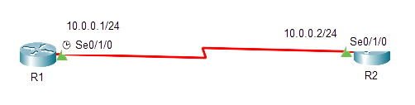

Basic Configurations
Process ID: 32 bit Process ID is a number used to identify an OSPF routing process on the router. Multiple OSPF processes can be started on the same router. This process ID is locally significant. Its range is 0 to 65535.
Network ID: Advertising network’s IP address.
Wildcard Mask: Tell the IOS which portion of the bits to match or ignore.
Decimal 0 (Min): The router must compare this octet as normal .
Decimal 255 (Max): The router ignores this octet, considering it to already match.
Area ID: OSPF area number in which this interface/network will exist.
‘R1(config)# router ospf <process ID>’
‘R1(config-router)# network <network ID> <wildcard mask> area <area ID>’

Slide 17
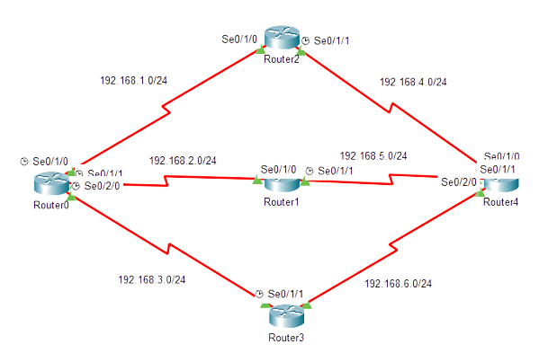
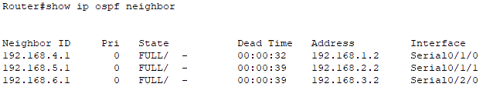
Neighbor Table
Neighbor ID: The router ID of the neighbor.
Pri: The priority value is used in the OSPF neighbor election process. It determines the likelihood of a router becoming the Designated Router (DR) or Backup Designated Router (BDR) on a multi-access network segment.
State: The current status of neighborship.
Dead Time: time interval within which OSPF routers expect to receive Hello packets from their neighbors, if not received it will go to down state.
Address: IP address of the neighbor.
Interface: the specific interface through which the OSPF neighbor is reachable.
Table-1: Neighbor Table

Slide 18
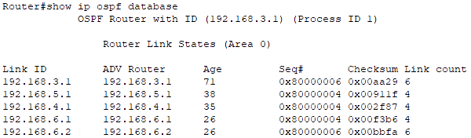
Database Table
OSPF Database Table is called LSDB.
Each Entry in LSDB is known as LSA.
Seq#: Each LSA has a sequence number associated with it, which helps routers track the most recent version of the LSA. If a router receives an LSA with a higher sequence number, it indicates a more recent update.
Checksum: A checksum value calculated for the LSA's contents. Routers use this value to verify the integrity of the LSA during transmission.
Link count: The number of individual links or entries within the LSA. The number of links can vary depending on the LS type.
Table-2: Database Table
Link ID: What the Link State ID contains depends on the type of LSA.
ADV Router: IP address of the OSPF router that originated or advertised the LSA.
Age: indicates how long (in seconds) ago the LSA was originally generated by the advertising router. It helps routers determine the freshness of the routing information.

Slide 19
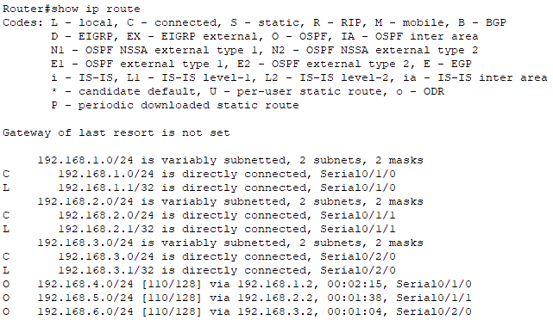
Route Table
Destination Network IP address with its Subnet Mask (CIDR) value.
Administrative Distance and Cost (Metric) value (lowest).
Next Hop ID Address
Existing Route duration time.
Interface through which traffic should be sent to reach the destination network.
Table-3: Route Table

Slide 20
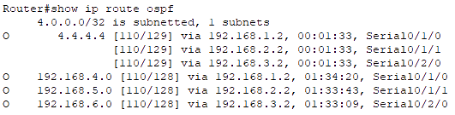
OSPF Route Table
In Route Table, we only get the best route to get to the destination network. But in OSPF Route Table, we get every possible route found to get to the destination network by OSPF routing protocol with their Destination IP Address (with CIDR value), Administrative Distance, Cost (Metric), Next Hop IP Address, Existing Route Duration Time and Source Interface IP Address.
Table-4: OSPF Route Table

Slide 21
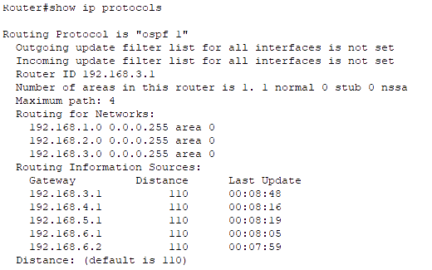
Protocols Table
In Route Table, we only get the best route to get to the destination network. But in OSPF Route Table, we get every possible route found to get to the destination network by OSPF routing protocol with their Destination IP Address (with CIDR value), Administrative Distance, Cost (Metric), Next Hop IP Address, Existing Route Duration Time and Source Interface IP Address.
Table-5: Protocols Table

Slide 22
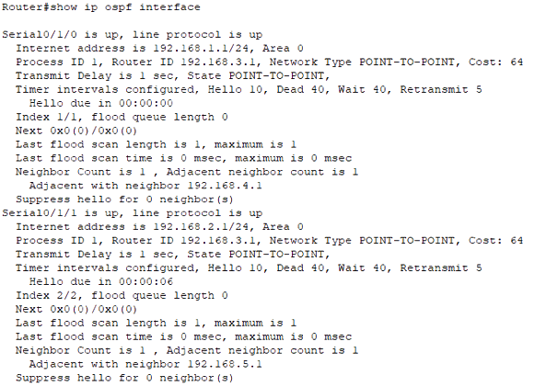
Interfaces
This command provides details about OSPF-enabled interfaces, including their state, IP addresses, area assignments, hello time, dead time, waiting time, process ID and many more.
To see summary of OSPF interfaces apply this command-
‘Router# show ip ospf interface brief’

Slide 23
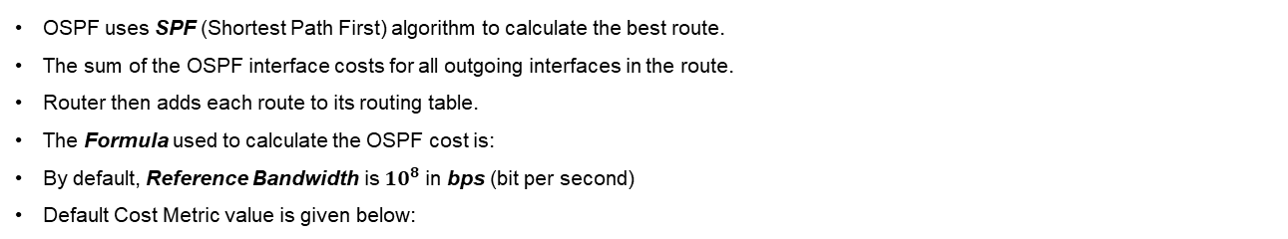

Cost Metric
OSPF uses SPF (Shortest Path First) algorithm to calculate the best route.
The sum of the OSPF interface costs for all outgoing interfaces in the route.
Router then adds each route to its routing table.
The Formula used to calculate the OSPF cost is:
By default, Reference Bandwidth is ${10}^{8}$ in bps (bit per second)
Default Cost Metric value is given below:
Cost $=\frac{Reference Bandwidth}{Interface Bandwidth}$
Interface | Interface Default Bandwidth (Kbps) | Formula (Kbps) | OSPF Cost
Serial | 1544 | 100,000/1544 | 64
Ethernet | 10,000 | 100,000/10,000 | 10
Fast Ethernet | 100,000 | 100,000/100,000 | 1
Gigabit Ethernet | 1,000,000 | 100,000/1,000,000 | 1
10 Gigabit Ethernet | 10,000,000 | 100,000/10,000,000 | 1
100 Gigabit Ethernet | 100,000,000 | 100,000/100,000,000 | 1
Notes:
Let, my pc connected interface can support 1000mbps, but my ISP gave me bandwidth of 15mbps. This means, maximum data transmission through this cable will be 15mbps my ISP gave me, but it can support upto 1000mbps.

Slide 24



Cost Metric
There are three ways to change interface cost in cisco routers:
Changing Interface Bandwidth: It will change the total cost metric of interface by using the interface subcommand- ‘bandwidth <value>’
Changing Default Reference Bandwidth: Any interface with an interface bandwidth of 100 Mbps or faster ties with a calculated OSPF cost of 1 which is a limitation. It is probably not the right basis for choosing routes. It can be changed by using this command- ‘auto-cost reference-bandwidth <value>’
Changing Cost Manually: Manually setting the cost will replace the calculated cost metric. Thus the calculated best route might also change. We can change the cost manually using the interface subcommand- ‘ip ospf cost <value>’
***Cisco recommends making the OSPF reference bandwidth settings the same on all OSPF routers in an Enterprise Network.
Notes:
Cisco recommends making the OSPF reference bandwidth setting the same on all OSPF routers in an enterprise network because it helps to ensure that all routers calculate the OSPF cost for each link in the same way. Else, the OSPF cost for a link will also be different, which can lead to routing loops and other problems. It can also lead to suboptimal routing. If there is a problem with OSPF, it can be difficult to troubleshoot which can make it difficult to identify the root cause of the problem.

Slide 25
OSPF Area
Single Area Limitations:
Larger topology requires more memory on router.
Too many LSAs may cause network overload.
Take more CPU time & resources to run SPF algorithm.
A single interface status change anywhere forces every router to run SPF again.
Convergence time becomes very slow.
OSPF Multiple Area:
Multiple area allows to logically group set of routers in one area.
It will break one large LSDB into several smaller LSDBs.
Minimizes the CPU & memory resources.
Convergence becomes fast.
Any changes are restricted, LSA advertised in the particular area only.
OSPF area range 0 to 4294967295.
OSPF Multiple Area Design Rules:
In each area, recommended number of router is less than 30 to 50.
Two or more area must have at least one area named ‘area 0’ which is called the backbone area.
All the non-backbone areas must connect to area 0. Else it cannot advertise its networks in other areas by default.
There must be at least one ABR (Area Border Router) connecting two or more areas.
Interfaces of both routers facing must be in the same area.

Slide 26
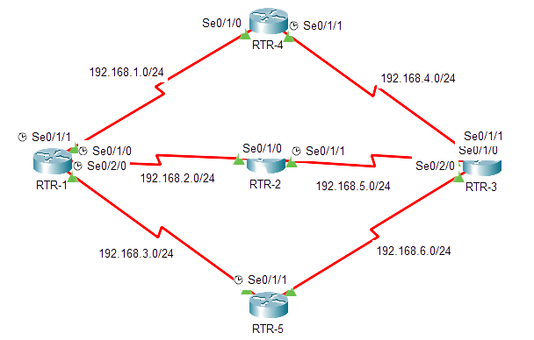





Multiple Area Configuration
ABR
ABR
Area 1
Area 0
Area 2
***Router doesn’t belong to any area, only router’s interfaces belong to specific areas.

Slide 27
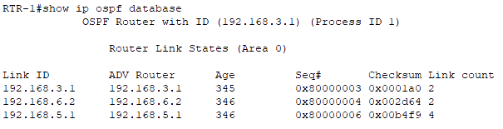
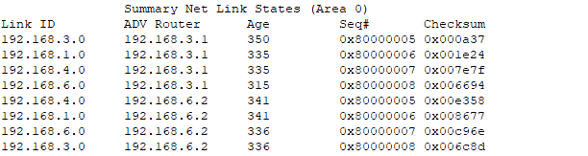
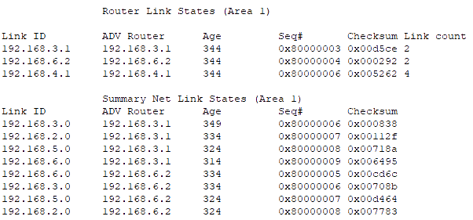
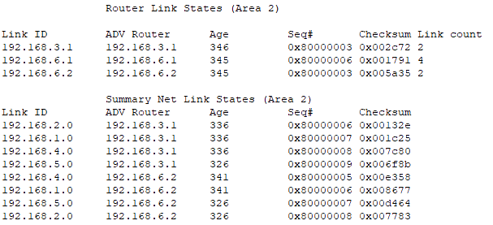
Multiple Area Database Tables
1
2
3
4
***OSPF Areas create a 2-Tier Hierarchy:
Area 0 – Top of Hierarchy – Backbone Area (Assures loop free area topologies, also Hub and Spike design)
Area # – All other Areas

Slide 28
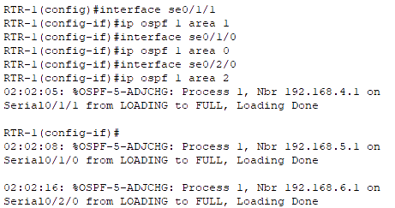
OSPFv2 Interface Subcommands
We can use Interface Subcommands instead of using the network command in global config mode to advertise OSPF- ‘Router(config)# interface <interface name>’ ‘Router(config-if)# ip ospf <process ID> area <area no>’
It can also be used in sub-interfaces using these commands- ‘Router(config)# interface g0/0.1’ ‘Router(config-if)# ip ospf 1 area 0’ ‘Router(config-if)# interface g0/0.2’ ‘Router(config-if)# ip ospf 1 area 0’ ‘Router(config-if)# interface g0/0’ ‘Router(config-if)# ip ospf 1 area 0’
Notes:
In Sikandar Shaik’s video about ospf interface subcommands, he said that if we advertise OSPF network as usual, it will show something like “Attached via Network Statement” and if we use interface subcommands, it will show something like “Attached via Interface Enable” in show ip ospf interface <interface name> command. There will be also difference in output in using show ip protocols command. But these changes haven’t been shown in cisco packet tracer simulator, so not sure about it happends still now or not in real devices.

Slide 29
Types of Routers
IR (Internal Router): IRs are routers that have all their interfaces in the same OSPF area. They don’t have interfaces in multiple OSPF areas. They maintain the OSPF Database for their area and participate in the calculation of the best routes within the area.
ABR (Area Border Router): An ABR is a router that is connected to two or more OSPF areas. They maintain an LSDB for each area and serve as a gateway, thus summarize routes from one area to another, reducing the size of the OSPF database in each area.
ASBR (Autonomous System Border Router): Connect the OSPF routing domain to external networks or other routing domains, such as those using different routing protocols. ASBRs redistribute external routes into the OSPF routing domain and vice versa.
BR (Backbone Router): Backbone Routers are routers that have at least one interface in the OSPF backbone area (Area 0). Backbone Routers are crucial for interconnecting OSPF areas.
DR (Designated Router): Elected on multi-access network segments (Ethernet) to reduce OSPF traffic and adjacencies. The DR is responsible for generating network-specific LSAs (Type 2 LSAs) & forwarding OSPF updates to other routers on the same segment.
BDR (Backup Designated Router): The BDR monitors the DR and quickly assumes the DR role if the DR becomes unavailable. This ensures redundancy and stability on multi-access segments.
VLR (Virtual Link Router): Virtual Routers are routers that establish virtual links to connect OSPF areas when physical connectivity to the backbone area (Area 0) is not possible. They allow routers in non-backbone areas to reach the backbone area indirectly.
SR (Stub Router): A stub router is a router that is connected to only one OSPF area and does not exchange routing information with other areas. Stub routers are typically used in small networks.

Slide 30
Network Types
Primarily, there are three types of OSPF network-
OSPF
1. Point-to-Point
2. Broadcast Multi Access
3. NBMA (Non Broadcast Multi Access
A point-to-point network is a network where two routers are directly connected to each other. This type of network is typically used for serial links by default.
A broadcast network is a network where all routers are connected to a single broadcast domain. This type of network is typically used for Ethernet networks by default.
An NBMA network is a network where multiple routers are connected to a shared medium, but they don’t have broadcast capabilities and this type of network is typically used for Frame Relay & ATM networks.

Slide 31
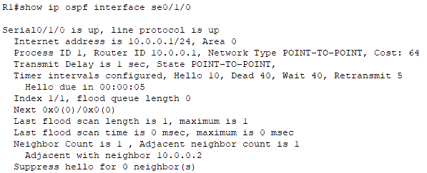

Point-to-Point Network
A single point-to-point link is a single pair of router.
Does not support the ability to add a third router to the link.
Usually a serial interface running either PPP or HDLC.
May also be a point-to-point sub-interface running Frame Relay or ATM.
No election of DR or BDR is required.
OSPF packets are sent using multicast 224.0.0.5.
OSPF auto-detects this interface type.
Point-to-Point over Ethernet Links:
Most of the WAN Ethernet connections can be P2P. Like- Ethernet Private Wire Service, Ethernet Line, etc. In this scenario, Ethernet DR/BDR adds a extra convergence time. P2P over ethernet links can be done using the commands- ‘R1(config)# interface se0/1/0’
‘R1(config-if)# ip ospf network point-to-point’

Slide 32
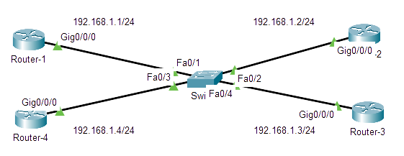
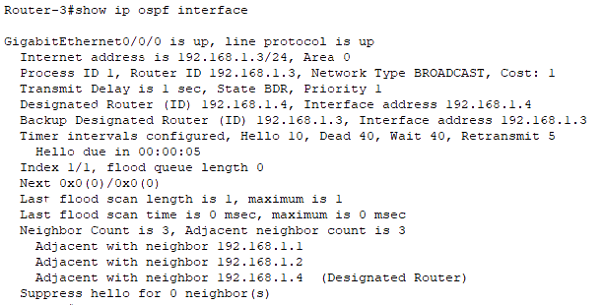
Broadcast Network
OSPF by default uses Broadcast network type on all types of Ethernet interfaces.
In broadcast multi-access networks there is two challenges-
Multiple adjacencies.
Flooding of LSAs.
These challenges are solved by electing DR and BDR.
All neighbor routers form full adjacencies with the DR and BDR only.
The DROTHER routers will never update other routers in the network.
DROTHER DR, use multicast 224.0.0.6 DR DROTHER, use multicast 224.0.0.5.
DROTHER
DROTHER
DR
BDR
Notes:
Multiple adjacencies- Routers from neighbors all routers (same broadcast domain).
Flooding of LSAs- Possibility of the creating multiple LSU loops.

Slide 33
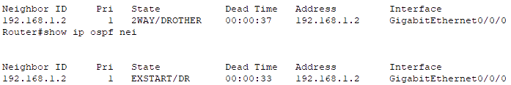
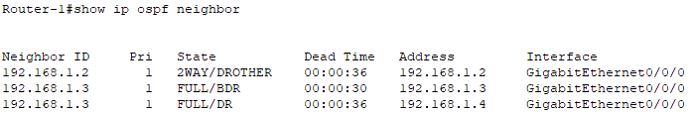
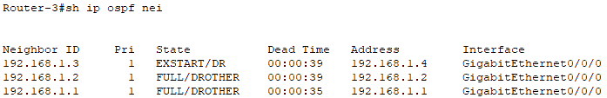
DR and BDR Election
The router having highest priority will become DR.
The router with second-highest priority is BDR.
The default priority value is 1.
The range of priority value is 0-255.
In case of a tie,
Router with highest router ID is DR.
Second highest router ID becomes BDR.
This DR/BDR election occurs during OSPF neighborship, specifically during the last phase of 2-Way neighbor state and just before the Exstart state.
If router priority is 0, it cannot become DR/BDR.
DR/BDR election is not preemtive.
If a new router is added within the topology with a better priority value after DR/BDR election, it does not preempt the existing DR and BDR until the current DR and BDR fail.
DR BDR – EXSTART DR/BDR DROTHER – FULL DROTHER DROTHER – 2-WAY
To change the priority value manually using the command- ‘Router(config)# interface <interface name>’ ‘Router(config-if)# ip ospf priority <priority value>’
Notes:
Multiple adjacencies- Routers from neighbors all routers (same broadcast domain).
Flooding of LSAs- Possibility of the creating multiple LSU loops.

Slide 34
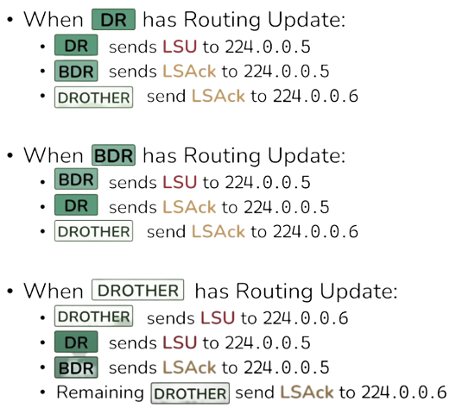
DR/BDR/DROTHER & OSPF Show Commands
‘show ip protocols’
‘show ip ospf interface’
Show ip ospf interface ?’
‘show ip ospf interface brief’
‘show ip neighbors’
‘show ip ospf rib’
‘show ip route’
‘show ip route ospf’
‘show ip ospf’
‘show ip ospf database’
‘show ip ospf database router (routerID)’
‘show ip ospf database network (networkID)’
‘show ip ospf database ?’
‘debug ip ospf ?’

Slide 35
OSPF Passive Interface
Passive Interface is used to prevent OSPF interfaces from sending OSPF Hello packets.
Thus, the passive interface does not participate in OSPF neighborship.
Instead, these interfaces only listen to OSPF updates and do not actively advertise OSPF routing information.
It can be used in Stub areas where no further OSPF routing information is needed.
It can be used on interfaces connected to external networks, such as the internet or untrusted networks.
It can be used to minimize OSPF traffic on specific links without affecting overall network functionality.
To make one or few interfaces as passive interface use these commands-
‘Router(config)# router ospf <process ID>’
‘Router(config-router)# passive-interface <interface name>’
In scenarios where multiple interfaces are need to make as passive interfaces excluding few interfaces, use these commands-
‘Router(config)# router ospf <process ID>’
‘Router(config-router)# passive-interface default’
‘Router(config-router)# no passive-interface <excluded interface name>’
The ‘passive-interface default’ command make all the interfaces as passive interface.

Slide 36
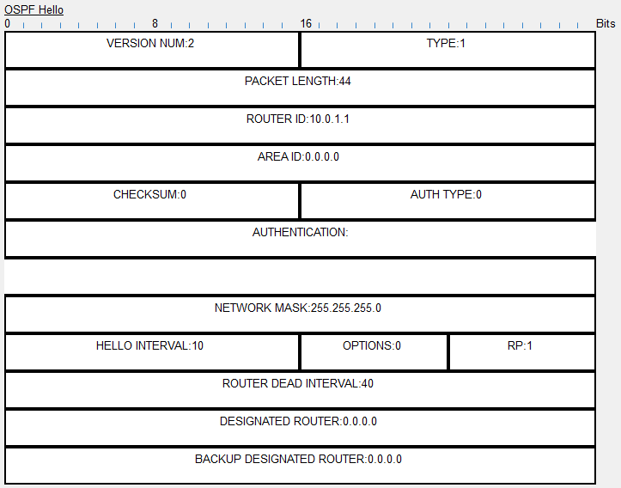
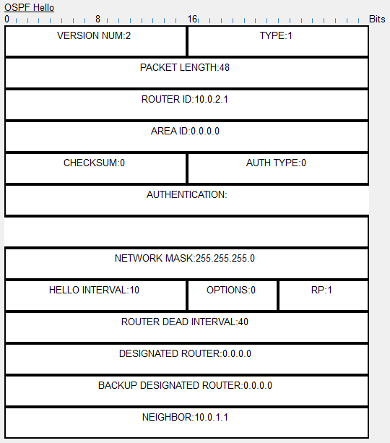
PDU – Packet Type 1 (Hello)
Notes:
NBMA: It refers to a type of network topology or technology commonly found in computer networking. In an NBMA network, multiple devices or nodes are connected to a common network segment or medium, but unlike a broadcast network (such as Ethernet), NBMA networks do not support the automatic broadcasting of data to all nodes on the network. Instead, communication in an NBMA network typically requires explicit addressing.

Slide 37
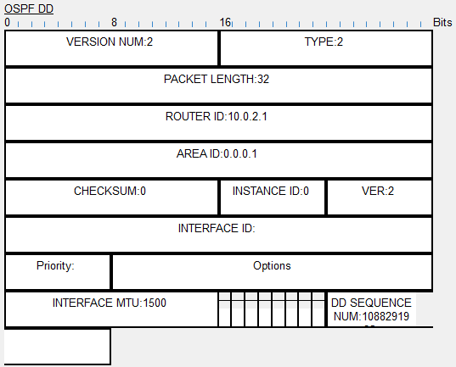
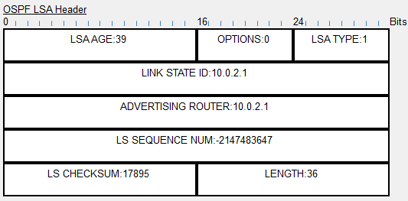
PDU – Packet Type 2 (DD)

Slide 38
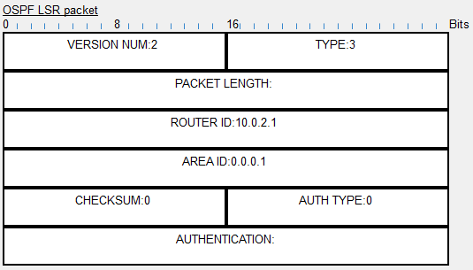
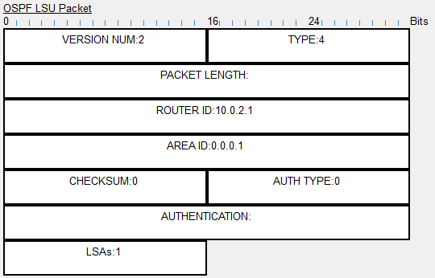
PDU – Packet Type 3 (LSR) & Type 4 (LSU)

Slide 39
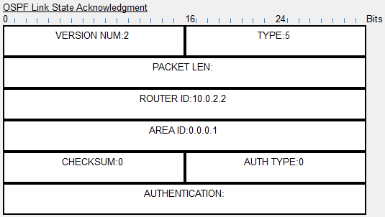
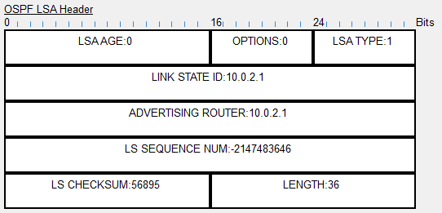
PDU – Packet Type 5 (LSAck)
PDU: A protocol data unit is a single unit of information transmitted among peer entities of a computer network.

Slide 40



Thank You
Feel free to reach out to me for any suggestions or feedback via LinkedIn or Mail
www.github.com/smsufi
www.linkedin.com/in/smsufi
safwanm.cse@gmail.com

Slide 41
References
https://en.wikipedia.org/wiki/Open_Shortest_Path_First
https://www.youtube.com/@SIKANDARshaik/playlists
https://www.youtube.com/@kushalkabi/playlists
https://www.youtube.com/@Certbros/playlists
https://www.geeksforgeeks.org/open-shortest-path-first-ospf-protocol-states/
https://www.cisco.com/c/en/us/support/docs/ip/open-shortest-path-first-ospf/7039-1.html
https://study-ccna.com/ospf-overview/
https://networklessons.com/ospf/basic-ospf-configuration
https://www.javatpoint.com/ospf-protocol
https://www.techtarget.com/searchnetworking/definition/HELLO-packet#:~:text=A%20HELLO%20packet%20is%20a,First%20(OSPF)%20communications%20protocol.
https://www.n-study.com/en/ospf-detail/ospf-hello/
https://techhub.hpe.com/eginfolib/networking/docs/switches/5500hi/5998-5330_l3-ip-rtng_cg/content/351988006.htm#279688693
https://www.n-study.com/en/ospf-detail/ospf-packet/

